Slide 1
Familiarize yourself with phishing attacks
<teams identified as most at risk>

Slide 2
What is phishing?
Do you know what is fishing? We use a bait to catch a fish.
Phishing is very similar to it. A sneaky cybercriminal sends you an email with graphics and fonts that make it appear to come from your organization. The attack will lure you in, using some kind of bait to fool you into making a mistake. Phishing attacks may strike using your email, text messages, or websites to trick you by posing as a trusted person or organization.

Slide 3
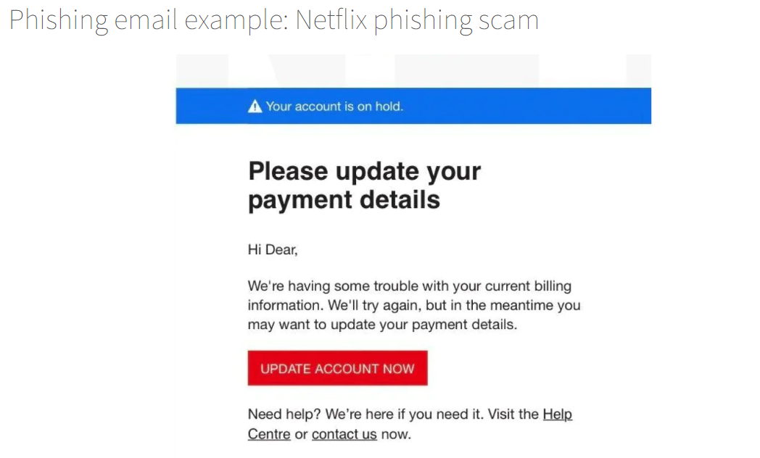
Learn to spot phishing emails

Slide 4
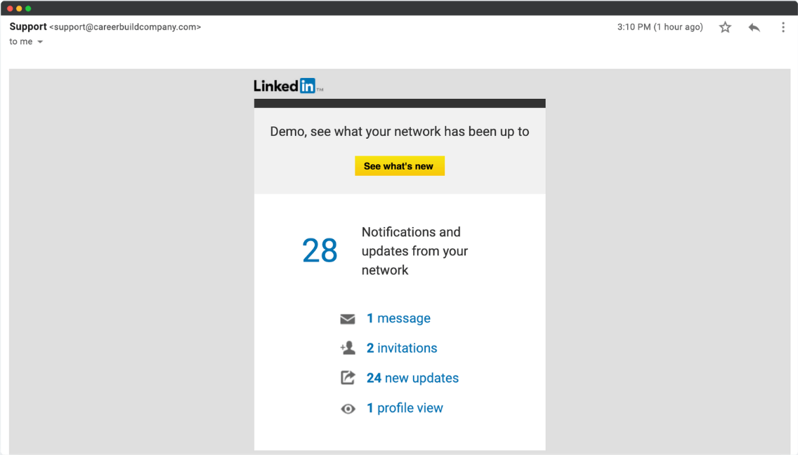
LinkedIn Phishing Email Example

Slide 5
How do we stop getting phished?
7 ways to spot phishing email: -
Emails demanding urgent action.
Emails that have incorrect grammar or spelling mistakes.
Emails with unfamiliar greeting.
Emails with suspicious attachments.
Emails requesting login credentials, payment information or other sensitive data.

Slide 6
6. Too good to be true emails.
7. Inconsistencies in email addresses, links and domain names.

